Slide 1
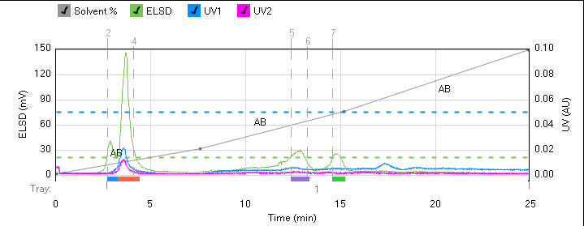
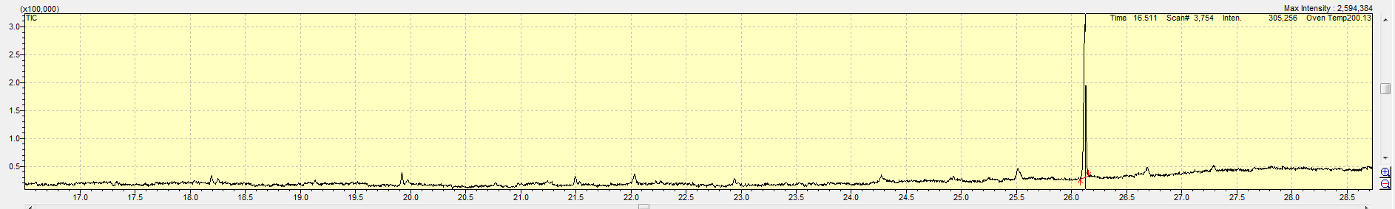
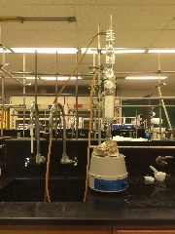
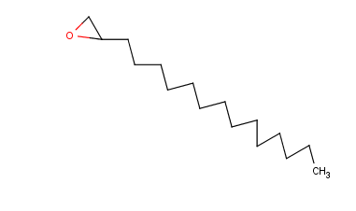
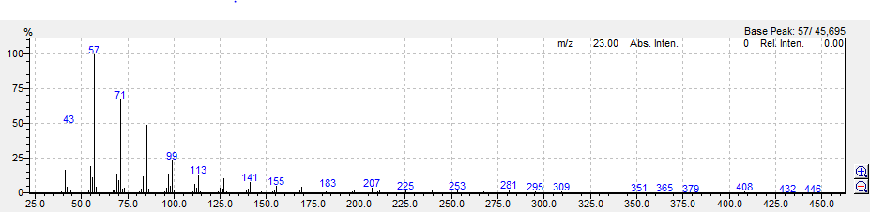
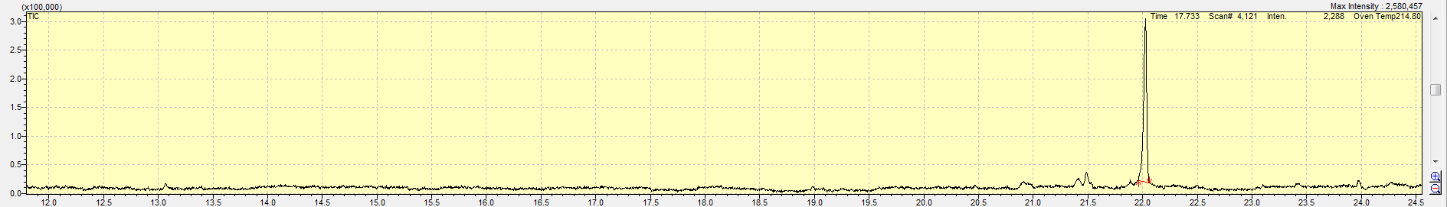
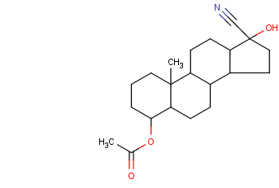
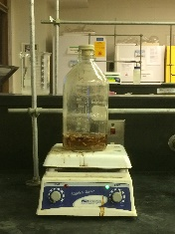
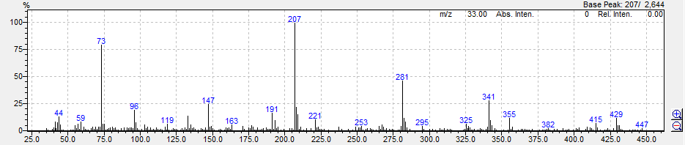
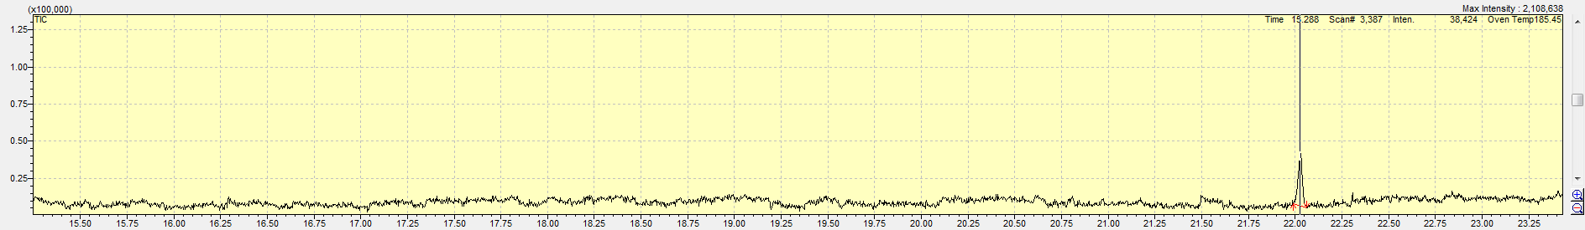
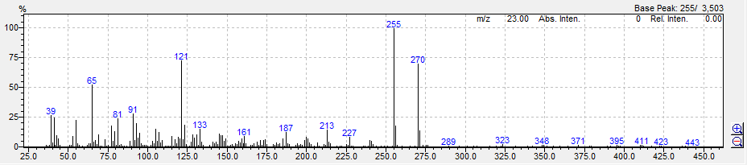
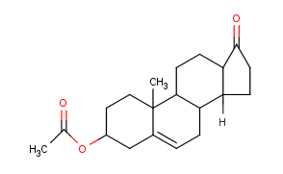
Analysis of Honey Locust Thorns Through Various Extractions
Wyatt Eaton
Dr. Jerome Easdon
College of the Ozarks Chemistry Department
Introduction
Honey locusts grow all over the United States. After being poked by said thorns, the victim may then feel fatigue, dizziness, and then see swelling in the place where they were poked. I want to see if there is a chemical that may cause these symptoms. My plan is to extract the chemicals from the thorns, test them for their structure, then see what chemical may be causing these symptoms.
Results
Discussion/Future Research
The extraction methods did work. Both the traditional extraction method as well as the Soxhlet method of extracting did yield results. I found my results to be; for every 10 grams of thorns I extracted .3g of chemicals from the thorns. The traditional method was the easier way to run the extraction, but I found the results to have more impurities as well as more residue in the solution from the thorns. The Soxhlet extractor yielded cleaner results and was quicker to use. Both had their advantages and disadvantages, but for my experiment, the Soxhelt extractor was the better extractor method. The Flash Chromatography instrument yielded three results from the test. The Gas Chromatography from each test gave my molecular weights of 446, 447, and 443.My results have lead me to the conclusion that there are lipids, steroids, and possible phytotoxins in the chemical makeup of honey locust thorns. More research on the molecular structures is needed and a comparison of that data to the toxic Black Locust bark to determine toxicity, if any, of the Honey Locust.
The Flash Chromatography yielded three separate compound from its separation. I used Hexanes and Ethyl Acetate to separate my compound. They were all clear liquids except for the third compound, it was yellow.
The compound 1had a molecular weight of 446. A major component for this group is a long carbon chain with an epoxide. Group blue yielded many results in long carbon chains leading to my conclusion that my product has lipid chains.
Methodology
1. Acquire thorns and cut them up into small
pieces. The small pieces will make the extraction
easier and it will make the thorns easier to work with.
2. Set up an Soxhlet Extractor (as seen to the right)
or a traditional extraction method.
3. Place 10 grams of thorns in filter for the Soxhlet
extractor or in a large jar with a stir bar for the
traditional extraction.
4a. Add 100 ml of Dichloromethane to the flask at the bottom of the Soxhlet extractor, place filter of thorns in extractor. Heat to a steady boil with the dichloromethane filling the filter of thorns. Let run for one-two days. Add more dichloromethane as needed.
4b. In traditional extraction (as seen to the right),
place 100 ml of dichloromethane in jar with the
thorns and stir bar. Leave in jar stirring for 5 days
to draw out as much chemicals as needed form the
thorns.
5. Run resulting solution with Flash
Chromatography and Gas Chromatography
to determine structure of chemical.
The compound 2 had a molecular weight of 447. A major component for this group is Androst-5-ene-17-carbonitrile, 4-acetoxy-17-hydroxyl-cyano-17-hydroxyandrost-5-en-4-yl acetate. The compound contains a Nitrogen group
which was expected to be found.
References
Toxic constituents in the bark of Robinia pseudacacia, J. Coll. Agr. Tokyo.Volume3. Pages337-56.Journal.1918
A extraction and separation method for antioxidant component in crude wood vinegar liquid, Faming Zhuanli Shenqing.6pp.Patent 2014.ODEN:CNXXEV
Solvent with effect of dissolving plant and use method thereof, Faming Zhuanli.Shenqing.5pp.Patent 2016. CODEN:CNXXEV
The compound 3 had a molecular weight of 443. A major component for this group is Dehydroisoandrosterone acetate. Leading to the conclusion of possible steroids in the compound.
Acknowledgements
College of the Ozarks for funding and support.
Drs. Jerry Easdon, Dr. Kenneth Garrison, and Dr. Gerald Rex for machine testing help.
Chase Sigler, and Abagayle Serreyn for consultation.

